Slide 1
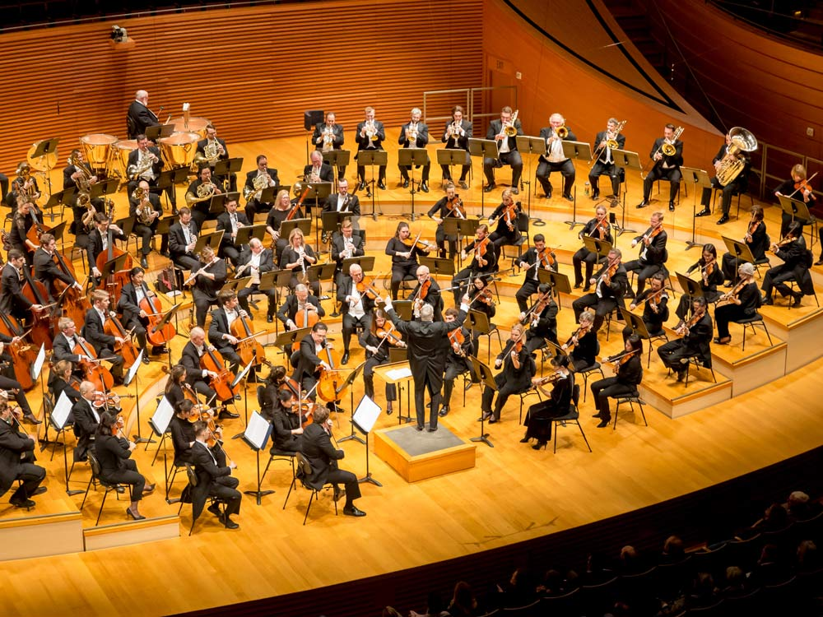
Future Work
Extending to more complicated waveforms to generate a full and unique sound library

Slide 2
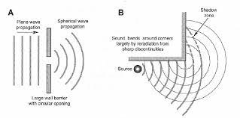
Future Work
Applying the procedural generation technique for approximate physics simulations of interacting waves

Slide 3
q_0
R_{x}(Θ_{A)}
U_{swap}(x)
R_{x}(Θ_{A)}

